Slide 1

Japan
Group Assignment : Data Science for Energy System Modelling
Group I
by
Fulham Karimu
Paburo-san
J (hehe)
Haythem Rezgui

Slide 2
Goal
Investigate a 100% renewable energy system for Japan
Shaping
Renewable Energy Pot.
Building a PyPSA Model
Investigation
Conclusion
Split the country in regions to simplify the simulation process
Study the renewable energy potential while taking into consideration the land’s limitations
It is a long established fact that a reader will be distracted by the readable content of a page when looking at its layout.
It is a long established fact that a reader will be distracted by the readable content of a page when looking at its layout.
It is a long established fact that a reader will be distracted by the readable content of a page when looking at its layout.

Slide 3
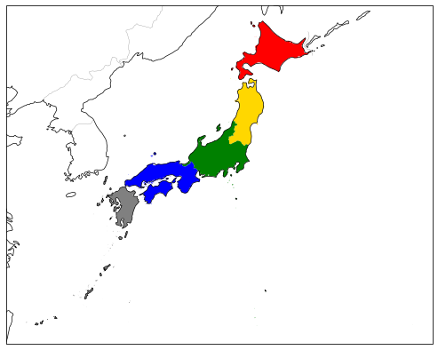
shaping
It is a long established fact that a reader will be distracted by the readable content of a page when looking at its layout.
60%
47%
72%
52%
39%

Slide 4
Renewable Energy Potential
I
It is a long established fact that a reader will be distracted by the readable content of a page when looking at its layout.
II
It is a long established fact that a reader will be distracted by the readable content of a page when looking at its layout.
III
It is a long established fact that a reader will be distracted by the readable content of a page when looking at its layout.
IV
It is a long established fact that a reader will be distracted by the readable content of a page when looking at its layout.

Slide 5
PyPSA
It is a long established fact that a reader will be distracted by the readable content of a page when looking at its layout.
20%
35%
It is a long established fact that a reader will be distracted by the readable content of a page when looking at its layout.
45%
It is a long established fact that a reader will be distracted by the readable content of a page when looking at its layout.

Slide 6
Investigation
I
It is a long established fact that a reader will be distracted by the readable content of a page when looking at its layout.
II
It is a long established fact that a reader will be distracted by the readable content of a page when looking at its layout.
III
It is a long established fact that a reader will be distracted by the readable content of a page when looking at its layout.
IV
It is a long established fact that a reader will be distracted by the readable content of a page when looking at its layout.

Slide 7
Thank you for your Attention

Slide 8
Additional Slides

